Slide 1

Air Quality Forecasting System
An automated MLOps pipeline predicting AQI for Karachi's Pearl regions using one year of OpenWeather data, recursive forecasting, and continuous model retraining.

Slide 2
System Architecture Overview
Data Collection
Feature Engineering
Hourly OpenWeather API ingestion with 40+ raw features: temperature, humidity, wind speed, pressure, PM2.5, PM10, NO₂, O₃, CO, visibility.
30+ engineered features including lag variables, rolling statistics, time-based features, and interaction terms capturing short-term and seasonal dynamics.
Model Training
Prediction & Visualization
Random Forest selected as best model (Test R²: 0.70, MAE: 17.63) trained daily on one year of preprocessed data from Hopsworks.
72-hour recursive forecasting with Streamlit dashboard displaying color-coded AQI categories and hazard warnings for public awareness.

Slide 3
Data & Feature Engineering
Raw Data Sources
Feature Categories
OpenWeather API provides 12 months of hourly observations. Standard AQI computed manually using EPA breakpoint formula since API lacks native AQI calculation.
Raw features: 10
Time-based: 10
Lag features(past AQI readings): 20
Pollutants & weather: raw input data
Rolling statistics(smoothed or averaged AQI trends from recent hours): 15
Lag & rolling features: historical context
Change & std: AQI trend and stability
Change rates: 10
Time encodings: temporal patterns
Interactions: 5
Target: standard_aqi_next_24h
Targets: 3
Missing Data Handling: Forward-fill → backward-fill for gaps, median imputation for numeric columns. Leakage columns dropped to prevent data contamination.

Slide 4
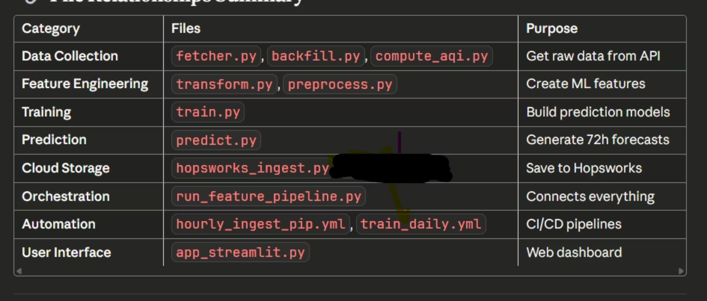

Slide 5
Model Performance & Selection
Model
Test R²
MAE
RMSE
Decision Tree
0.65
18.5
22
XGBoost
0.57
21.26
26.07
LightGBM
0.59
21.01
25.32
Random Forest
0.7
17.63
21.76
Random Forest deployed: Best generalization on 1-year data. XGBoost and LightGBM overfit; SARIMAX failed at annual scale. Highest accuracy for 6h and 24h forecasts.

Slide 6
Recursive Forecasting Pipeline
01
02
Load Model & History
Generate Timestamps
Retrieve trained Random Forest, scaler, feature medians, and last 48 hours of data from Hopsworks or local backup.
Create 72 future hourly timestamps for prediction horizon.
03
04
Iterative Prediction
Save Forecasts
For each hour, engineer features from combined history, predict AQI, append prediction as input for next step.
Output 72 rows of predictions to predictions.csv for dashboard visualization.
Performance: Reliable up to 24h; moderate accuracy to 72h with minor drift. Recursive approach reuses predicted values as features for subsequent steps.

Slide 7
Automation & CI/CD Infrastructure
Hourly Ingestion
Daily Training
Continuous Monitoring
GitHub Actions runs every hour: fetches latest data, computes AQI, engineers features, updates Hopsworks Feature Store, generates predictions.
Runs at 02:00 UTC: retrains Random Forest on full year of data, evaluates performance, uploads model to Hopsworks if R² ≥ 0.70.
All workflows log execution to GitHub Artifacts. Ensures uninterrupted predictions and model freshness without manual intervention.

Slide 8
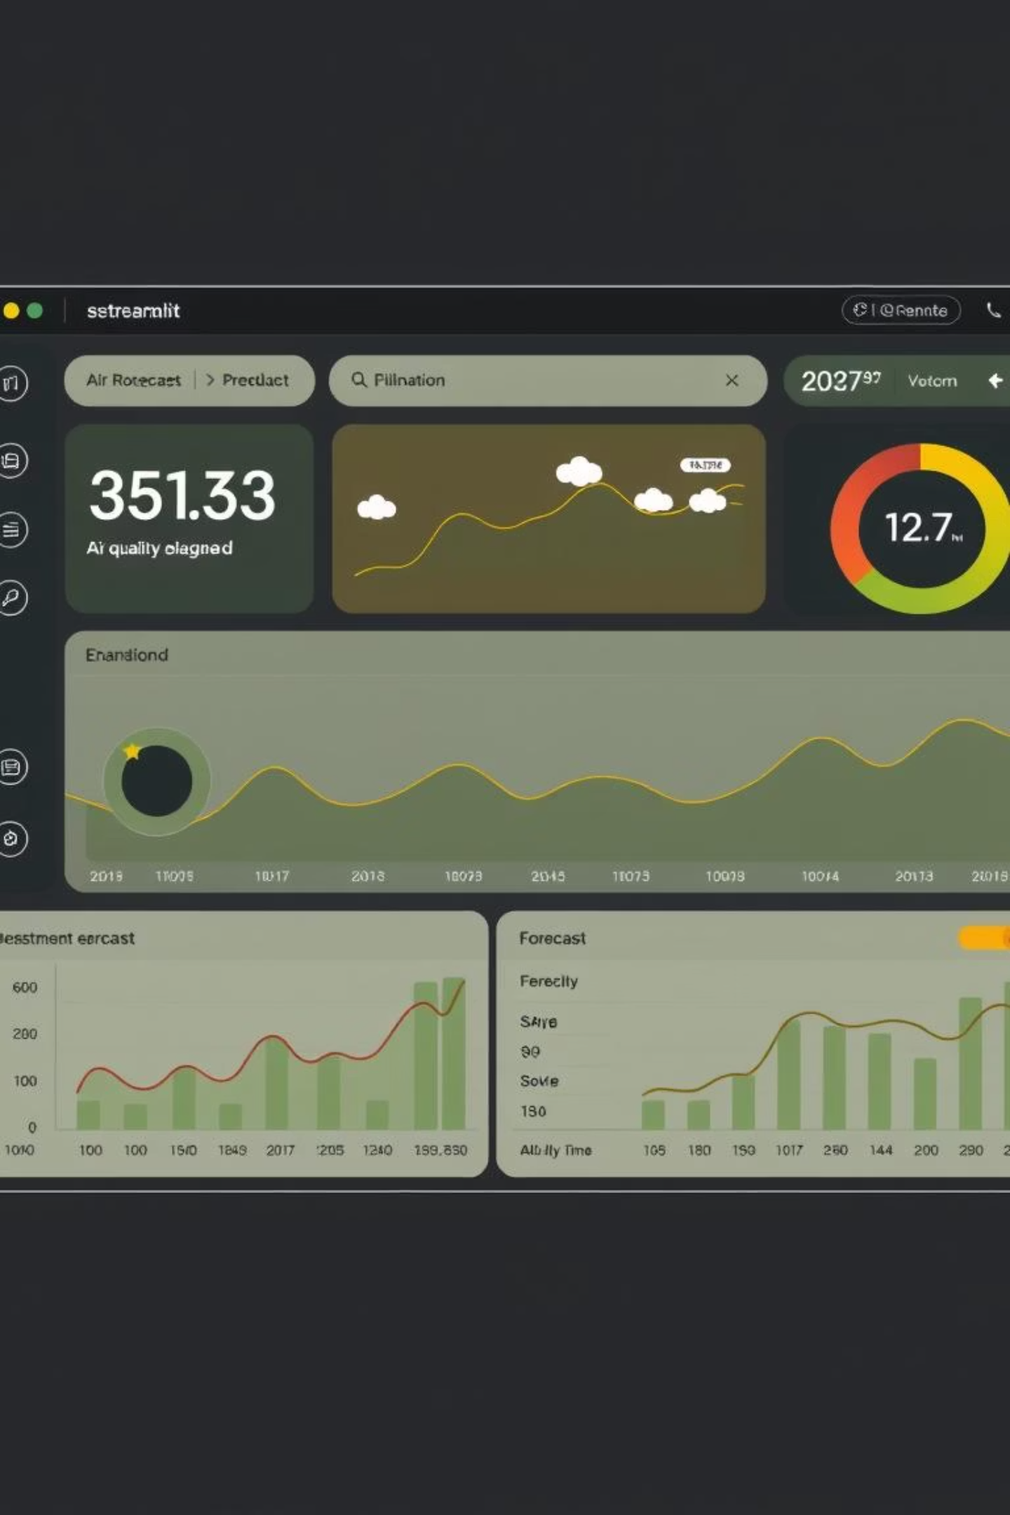
Dashboard & Key Technologies
Streamlit Dashboard
Tech Stack
Real-time visualization of 72-hour AQI forecasts with color-coded categories (Good to Hazardous). Displays pollutant trends, issues warnings for AQI > 200, updates automatically after each CI/CD run.
Languages: Python, Pandas, NumPy
Models: Random Forest, XGBoost, LightGBM
MLOps: Hopsworks Feature Store & Registry
Automation: GitHub Actions
Visualization: Streamlit, Matplotlib, Seaborn

